Slide 1
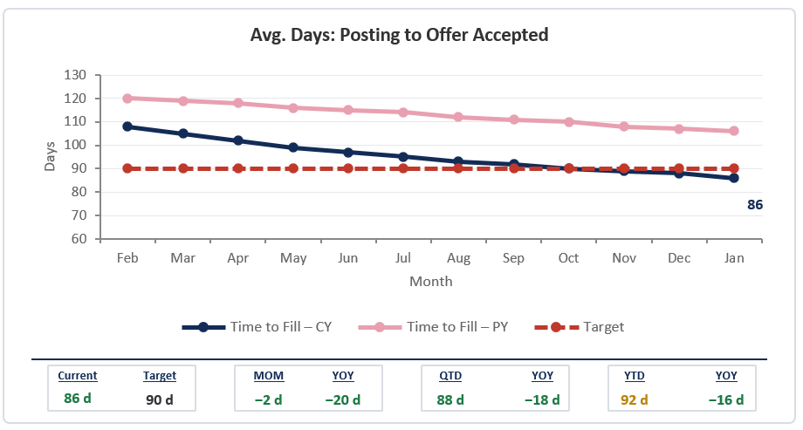

3- YOUR MATERIALS
QBR Standard Graph
Standard chart formats. Goal is to make information understandable to executives in under 10 seconds.
Data over time. The standard graph is a trendline. You can combine weekly and monthly data on one chart. Use secondary slides when required to support discussion.
Three reference points. Current year (CY). Prior year (PY). Target.
Metric Strip. Show month‑over‑month, year‑over‑year, quarterly, and year‑to‑date comparisons.
On Track, At Risk, Off Track. Use a label to clearly identify the trend.
Tool Agnostic. Can be PowerPoint, Power BI, or another tool, as long as printable and includes all the standard report components.
As real-time as the data allows. Anything less frequent than monthly generally loses operational value because the data becomes too lagged to support active decision‑making.
Every chart plots CY vs. PY with a dashed red target line. One metric per slide.
Narrative (not shown). Key Takeaways, Drivers, Decisions/Actions.
Page Numbers (not shown). Allows for jumping around the deck.
Collaborative and iterative. We will refine shared standards across departments together.
12

Slide 2
3- YOUR MATERIALS
Standard Report Template
Time to Fill
On Track
At Risk
Off Track
Avg. Days: Posting to Offer Accepted
NOTES
Key Takeaways
86 days posting-to-offer, under target
Down 20 days YOY
Key Drivers
Scale promising XYZ pilot countywide (e.g., piloting a new program, tool, policy)
Decision/Action Needed
None at this time
86
Current
Target
MOM
YOY
QTD
YOY
YTD
YOY
86 d
90 d
−2 d
−20 d
88 d
−18 d
92 d
−16 d
Time to Fill — Hire: Average calendar days from a position posting to an accepted offer. Source: Mock Neogov Data
2
Notes:
Optional: You can include your logo or department branding.
Must haves: For the quarterly reporting, consistency matters. Use a clear metric title. One measure per slide. A snapshot of your graph goes on the left side. Ideally your graph includes the strip at the bottom that demonstrates how the current month compares to other time periods. The graph should have three points of reference and be as real-time as the data allows. See slide 1 for additional guidance. Below the graph is the definition, source information, and any other information such as data quality. On the right side are key takeaways. There is a slide number on the bottom right corner.
This month compared to last month
This month compared to this month last year
This quarter (average)
This quarter compared to this quarter last year
This year to date (average)
This year to date compared to this year to date last year
Confirming you want us to show last 12 months, and not fixed calendar year (Jan-Dec) on the x-axis? Yes, by calendar year (last 12 months)
Confirming phrases or sentences in the Notes box? Clear phrases are fine without periods

